Slide 1
PRESTO: Improvements of Industrial Real-Time Embedded Systems Development Process
{Shuai.Li}{Michel.Bourdelles}{Arnaud.Trottet}@fr.thalesgroup.com
THALES Communications & Security
3rd FITTEST Industrial Day May 31st 2013

Slide 2
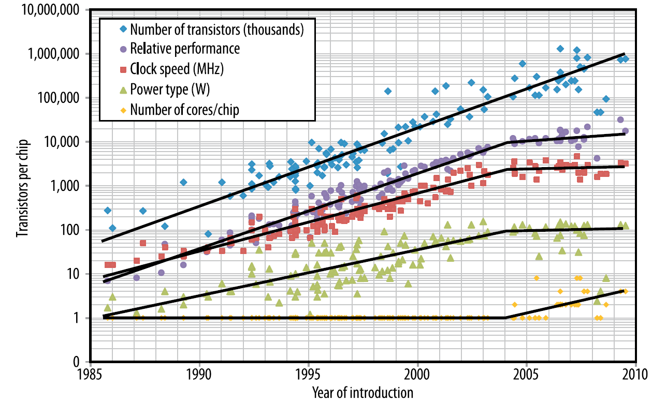
Project Context: Real-Time Embedded Systems
3rd FITTEST Industrial Day May 31st 2013

Slide 3
Project Goal
Current Design Difficulties
RTES constrained by resources available (e.g. processor, power)…
…but it is difficult to proceed to performance analysis at an early stage in design when the execution platform is not available.
PRESTO General Idea
Provide tools to evaluate Software/Hardware allocations
…by analyzing functional and non-functional properties…
…and integrating tools into an industrial development process.
3rd FITTEST Industrial Day May 31st 2013

Slide 4
Project Synopsis
Modeling
Software Requirements
(Functional and non-functional)
Software
Model
Platform
Model
Platform Requirements
Software Test
Design and Implementation
on Reference Platform
Analysis
Behavior Capture
Functional
Verification
Test Trace
Generation
Extrapolation
Estimation
Platform Prototype
Non-Functional
Verification
?
3rd FITTEST Industrial Day May 31st 2013
Software Test on Real Platform

Slide 5
Project Technical Relevance
Behavior Capture
Instrumentation strategies
Instrumentation impact
Trace generation
Trace interoperability
Modeling
General RTES modeling with stereotypes (e.g. UML)
Domain specific modeling (e.g. application, analysis specific)
Formal modeling of functional and non-functional properties
Model interoperability
Analysis
Execution and specification trace comparison
3rd FITTEST Industrial Day May 31st 2013

Slide 6
Consortium
United Kingdom
France
3rd FITTEST Industrial Day May 31st 2013

Slide 7
Consortium
Finland
Italy
Greece
3rd FITTEST Industrial Day May 31st 2013

Slide 8
THALES Case-Study Demo
{Shuai.Li}{Michel.Bourdelles}{Arnaud.Trottet}@fr.thalesgroup.com
THALES Communications & Security
3rd FITTEST Industrial Day May 31st 2013

Slide 9
THALES Software Radio Case-Study
Functional Overview
Software radio application
TDMA radio protocol for mobile ad-hoc wireless networks
Software Architecture
Module
Module
Thread: Activated when message in buffer
Buffer: FIFO message storage
Module
Communication
3rd FITTEST Industrial Day May 31st 2013

Slide 10
THALES Software Radio Case-Study
Functional Overview
Software radio application
TDMA radio protocol for mobile ad-hoc wireless networks
Software Architecture
Business
Business
Business code: message processing
Business
Wrapper
Wrapper
Wrapper
Wrapper code: message reception and transmission
Business
Wrapper
Instrumentation
3rd FITTEST Industrial Day May 31st 2013

Slide 11
Experiment
Objectives
Software radio application modeling
Instrumented code generation from model
Execution trace generation
Trace visualisation with PRESTO partner tool
Instrumentation overhead evaluation
Experimented tools and methods
UML (MARTE) modeling language
Softeam’s Modelio modeler for PRESTO
PragmaDev’s MSC-Tracer analysis tool
Demonstration Time
3rd FITTEST Industrial Day May 31st 2013

Slide 12
Results
Instrumentation Overhead
Discussion
The instrumented execution does not result in any missed deadlines when they are equal to 100ms.
In other software radios, deadlines are on the scale of 1ms. Theoretically a maximum of 30 points are then allowed. In the experimental execution, deadlines would have been missed.
Instrumentation overhead can be limited by choosing active instrumentation points at model level.
Number of message types | 21
Instrumentation points hit during execution | 38
Single instrumentation point overhead (µs) | Min | Max | Avg
 | 31.00 | 40.00 | 33.09
Ratio (single overhead) / (total time) | 0.03%
Ratio (total overhead) / (total time) | 1.07%
3rd FITTEST Industrial Day May 31st 2013

Slide 13
Conclusion
Results
Trace generation flow
Functional information
Timing information
Instrumentation strategy and impact
Solution to ease modeling
Future Works
Exploit traces with formal properties in the model
Energy consumption information
3rd FITTEST Industrial Day May 31st 2013

