Slide 1


Network Monitoring for
Security Checking
Wissam Mallouli – Montimage
RCIS industrial day – May 31st 2013
wissam.mallouli@montimage.com

Slide 2
What is network monitoring
Process of observing or inspecting the network at different points
With the objective of
  Drawing operation baselines
  Produce reports
  Notify on abnormal operation
  Provide input to network management
Can be used to
  Understand the behavior of the network
  Network planning & resource optimization
  Detect faults and abnormal operation
  Network security (Intrusion & Attack Detection)
  Performance, quality & SLA monitoring
  CRM, Marketing
Sit above traffic measurements
  Gather traffic measures and performance/security indicators
  Analyze and correlate the measures in order to make a diagnosis
Notes:
Network monitoring is a laborious challenging task that is vital for a network operator, a service provider or a corporate network infrastructure in order to keep the network operation stable, smooth and safe.
To be able to optimize the available bandwidth
59% of institutions do not monitor or manage bandwidth at all (Belcher, 2005)

Slide 3
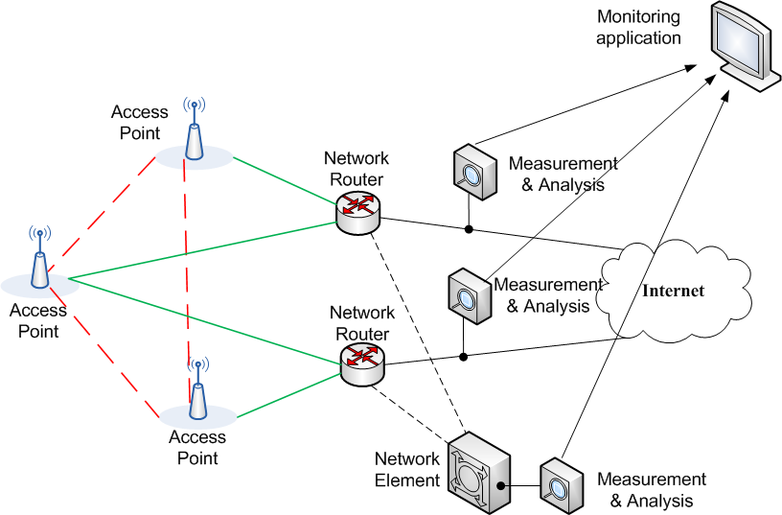
Network monitoring: Basics

Slide 4
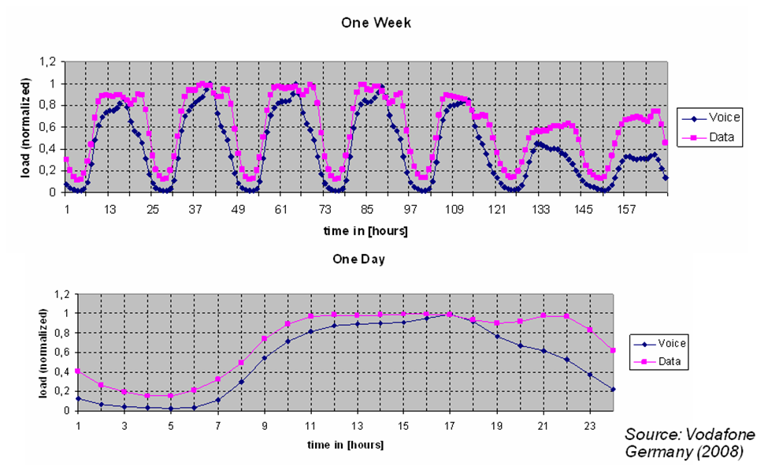
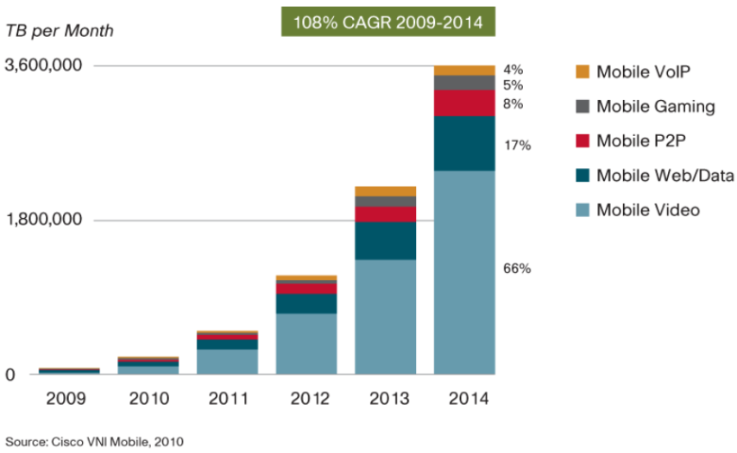
Need for network monitoring
Understand / Plan
Need to have a clear visibility over the network
Status, traffic trends, peak time, evolution, etc.
Aggressive pricing the week-end/night
3.5 billion mobile broadband users by 2015
Traffic increase 30 times (wrt 2010)
Understanding
  the drivers of this growth
  applications/usages
  → contribute for a successful network planning

Slide 5
Need for network monitoring
Diagnose & react
Remote User
Typical problem
  Remote user arrives at regional office and experiences slow or no response from corporate web server
Where to begin?
  Where is the problem?
  What is the problem?
  What is the solution?
Without proper network monitoring, these questions are difficult to answer
Regional Offices
WWW Servers
Corp Network

Slide 6
Need for network monitoring
Problems might still occur!
The Amazon Web Services Outage (April 2011)
Elastic Block Store: storage database for Amazon’s EC2.
  EBS clusters (Database nodes)
  Control Plane Services (accepts user requests and directs them to appropriate EBS clusters)
  Inter node communication on high bandwidth network and a lower capacity network as a back-up.
Manual Error with routine Network Upgrade Procedure (traffic directed to the low capacity network)
  many nodes were isolated.
  Etc. (for more info follow the link below)
Tens of sites and businesses impacted for 3 long days
(Source) http://aws.amazon.com/message/65648/

Slide 7
Network monitoring: Components
Monitoring application
Interface for real-time monitoring.
Gathers, aggregates and correlates collected information (events)
Measurement unit
This performs the measurements
Security analysis unit
This is where the measurements will be performed.
Observation points
Store collected data in a database for post analysis (history, reporting …).
Notify remote events
Collects the required information for analysis.
The more observation points we have, the more accurate data we get.

Slide 8
Complexity of network monitoring
Size, complexity and diversity of the networks
  understand cause-effect relationships is difficult
Measurement is not an objective!
  meaningless without careful analysis
  Analysis depends on the monitoring objective
  Need to define
    What, where, how to measure?

Slide 9
Monitoring requirements
High capturing performance
Extensibility
Scalability
Real time functioning
Granularity
Diversity
Low cost
Secure
Notes:
High capturing performance. The monitoring platform must be able to capture traffic at high traffic speeds and under high traffic volume.
Extensibility. If new services are integrated on the network, it must be possible to deploy effortlessly new monitoring mechanisms for these specific services.
Scalability. The monitoring platform must be able to handle the increase of traffic data as network links speeds grow and occasionally the number of devices in the network without performance degradation of the management system. Scalability can be achieved by reducing the traffic information collected using efficient packet capturing mechanisms and traffic pre-processing activities.
Real time functioning. The monitoring platform must implement real time mechanisms in order to quickly detect network security/performance problems and allow the service provider to take actions in a timely manner.
Granularity. The monitoring mechanisms must be able to track the security and performance of each service by capturing and analyzing the traffic of protocols used by this application.
Diversity. The monitoring platform has to support the network’s diversity as it contains many different kinds of network devices from multiple vendors, protocols stacks, and applications to provide services to the user.
Low cost. The monitoring system should not use excessive amount of computing, storage, and communication resources so the cost of deploying and operating the monitoring infrastructure is low for the service providers.
Secure: Do not add vulnerabilities to the network, or disturb network normal operation.

Slide 10
Deep Packet Inspection
Based Monitoring
What is DPI
  Application classification
  Traffic attributes extraction

Slide 11

What is DPI
Technology consisting of digging deep into the packet header and payload to “inspect” encapsulated content
  Content may be spread over many packets
Packet Header Layers
Packet Payload / Application Layers
L2
L3
L4
L5 – L7
Ethernet
Internet
Protocol
(IP)
Transport
Layer
(TCP/UDP)
Email (SMTP, POP3, IMAP)
Web (HTTP/S)
Instant Messaging (IM)
Peer-to-Peer (P2P) Applications
Deep Packet
Inspection

Slide 12
Why to DPI
Network Visibility
  Understand how bandwidth is utilized
    What is the application mix
    Who is using what, where and when?
Traffic Management (Application Control)
  Block undesired traffic (spam, worms, etc.)
  Prioritize and shape traffic (limit P2P, QoS, QoE)
  Advanced policy enforcement
  Zero Facebook, OTT services, per application policy rules
Security
  Understand network attacks
  Core component in next generation firewalls
Etc.

Slide 13
Inside DPI
Group packets belonging to the same session
Application classification
  Detect application type (Skype, Bittorrent, etc.) or application family
  Considered as the core of DPI
Protocol decoding and attribute extraction
  Parse the packet structure (this depends on the protocol & application)
  Get protocol attributes (IP @, port numbers, …)
  Get session attributes
  Events and attributes may involve different packets
    Attached file of an email

Slide 14
From classification to attributes and events extraction
Application classification is a first step towards accurate traffic information extraction
  How can we get the HTTP method (Get, Post, etc.) if we don’t know the type of the traffic
  When the application type is known decoding becomes “easy”
What are traffic attributes?
  Meta-attributes: timestamp, data source etc.
  Protocol field derived from the packet data: IP@, attachment size, encoding type, etc.
  Flow parameter: packet mean size, inter-arrival delay, packets lost, reordered, etc.
  The application class can be considered as a traffic attribute

Slide 15
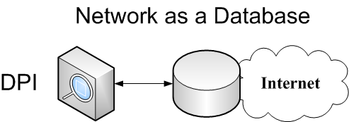
Attribute extraction with DPI
With the extraction capability, DPI can provide input for security analysis
Imagine the network as a database and DPI as an engine to extract data from this database!

Slide 16
Network as a Database
Select flow_id Where (application = email AND attachment is executable)
Select user_id, perceived_quality Where (application = Video AND protocol = RTP
AND perceived_quality < 1)

Slide 17
Security Monitoring with DPI
Using MMT
Abstract description
Challenges
Security properties

Slide 18
The HBGary Hack
HBGary - experts in computer security
  computer forensics and malware analysis tools to enable the detection, isolation, and analysis of worms, viruses, and trojans
  implementing intrusion detection systems and secure networking
  performs vulnerability assessment and penetration testing of systems and software
  rootkit.com is a respected resource for discussion and analysis of rootkits
CEO Aaron Barr wanted to unmask Anonymous
  Those responsible for co-ordinating the group's actions, including the denial-of-service attacks that hit MasterCard, Visa, and others late last year
Anonymous response
  HBGary's servers were broken into, its e-mails pillaged and published to the world, its data destroyed, and its website defaced. As an added bonus, a second site owned and operated by Greg Hoglund, owner of HBGary, was taken offline and the user registration database published
(source) http://arstechnica.com/tech-policy/news/2011/02/anonymous-speaks-the-inside-story-of-the-hbgary-hack.ars/1

Slide 19
The HBGary Hack
 | Attack Method | Attacked System | Vulnerability | Lost Assets
1 | SQL Injection | CMS on HBGary Federal's website, hbgaryfederal.com | CMS with missing validity check of SQL Parameters | usernames, e-mail @ & password hashes
2 | Password cracking using rainbow tables | Password hashes from 1 | Hashes without salt, weak passwords | clear text passwords
3 | Unauthorized use of passwords from 2 | E-mail, Twitter accounts, and LinkedIn accounts of HBGarry officials | Password double use | Email accounts of HBGary officials
4 | Unauthorized use of passwords from 2 | Machine running support.hbgary.com | Password double use | Non-superuser account of HBGary official
5 | Privilege escalation | Machine running support.hbgary.com | Privilege escalation vulnerability, system not up to date | Full access to HBGary's system, gigabytes of backups and research data
6 | Social engineering | Machine running rootkit.com |  | Integrity of rootkit.com

Slide 20
The HBGary Hack:
Where can security monitoring help?
 | Attack Method | Attacked System | Vulnerability | Lost Assets
1 | SQL Injection | CMS on HBGary Federal's website, hbgaryfederal.com | CMS with missing validity check of SQL Parameters | usernames, e-mail @ & password hashes
2 | Password cracking using rainbow tables | Password hashes from 1 | Hashes without salt, weak passwords | clear text passwords
3 | Unauthorized use of passwords from 2 | E-mail, Twitter accounts, and LinkedIn accounts of HBGarry officials | Password double use | Email accounts of HBGary officials
4 | Unauthorized use of passwords from 2 | Machine running support.hbgary.com | Password double use | Non-superuser account of HBGary official
5 | Privilege escalation | Machine running support.hbgary.com | Privilege escalation vulnerability, system not up to date | Full access to HBGary's system, gigabytes of backups and research data
6 | Social engineering | Machine running rootkit.com |  | Integrity of rootkit.com
SQL injection: In top ten most known vulnerabilities
(Top ten vulnerabilities are responsible for 60% of software bugs!)
Multi-lines security system: Is it possible to detect security attacks (SQL injection in this case) by inspecting the data encoded in inbound traffic?

Slide 21
Security monitoring with DPI:
Abstract description
The concept:
  Detect the occurrence of events on the network
    Input provided by DPI
    Event can be: packet arrival, HTTP POST request, etc.
  Inspect and analyze the succession of events to detect properties
    Property: Succession of events that are linked with “time” and “logical” constraints
      If we detect event “A”, then we MUST detect event “B” after 10 seconds
The idea:
  Monitor the network looking for the occurrence of properties.

Slide 22
Security monitoring using DPI:
Abstract description
Example: SQL injection
  www.abcd.com/page?name=Select * Where 1
  The events to be detected
    HTTP GET request
    URL parameter contains SQL statement
  The property
    It is not allowed to have a URL parameter containing SQL statement in an HTTP GET request
  If the property is detected on the network then most probably there is an attack attempt!
Nice Theory! But very challenging

Slide 23
Security monitoring using DPI
Challenges
  The number of events that can occur on a network is huge!
    Solution: Use DPI for the events extraction
    Group events/attributes by application and add new ones when needed
  The expressivity of the properties (need to combine time and logical constraints)
  Complex analysis and processing especially in high bandwidth links
    Optimization techniques, multi-core implementations, smart traffic filtering

Slide 24
Properties Expressivity
Considering security monitoring, properties can be used to express:
A Security rule describes the expected behavior of the application or protocol under-test.
  The non-respect of the Security property indicates an abnormal behavior.
  Set of properties specifying constraints on the message exchange
    i.e. the access to a specific service must always be preceded by an authentication phase
An Attack describes a malicious behavior whether it is an attack model, a vulnerability or a misbehavior.
  The respect of the Security property indicates the detection of an abnormal behavior that might indicate the occurrence of an attack.
  Set of properties referring to a vulnerability or to an attack
    A big number of requests from the same user in a limited period can be considered as a behavioral attack

Slide 25
Properties Expressivity
A security property is composed of 2 parts:
  A Context
  A condition to verify
The “Context” and “Condition” of a property are composed of:
  Simple events
    Conditions on attributes (IP @ equal to 1.2.3.4)
  Complex events linked by
    Logical operators (AND/OR/NOT)
    Chronological operator (AFTER/BEFORE)

Slide 26
Properties Expressivity
A security property is composed of 2 parts:
  A Context
  A condition to verify
The “Context” and “condition” of a property are composed of:
  Simple events
    Conditions on attributes (IP @ equal to 1.2.3.4)
  Complex events linked by
    Logical operators (AND/OR/NOT)
    Chronological operator (AFTER/BEFORE)
If an HTTP Response is received (this is the context)
Then an HTTP request should have been received before (condition to verify)

Slide 27
Montimage Monitoring Tool (MMT)
MMT Operator
Monitoring & reporting
Web technology
Management of multiple probes
User defined
Reports and views
Config
Traffic
DB
View
Plugins
MMT Probe
Analysis modules
Add analysis
modules
Traffic
Monitoring
Quality
Monitoring
Security &
Functional
Analysis
HW/SW Probe
Can be installed
on dedicated HW
MMT Extract
Deep Packet Inspection functionalities
Traffic classification (600+ protocols)
Protocol decoding & attributes extraction
Extraction of metrics
Software library
(SDK)
Can be integrated
in 3rd party SW
Protocol Plugins
Add plugins

Slide 28
Innovation
Model-driven security (or DevOpsSec)
  Modeling of security properties and attacks
  Applicable to testing and operation phases
  Allows checking compliance of security policies
  Automate security management and enforcement
  Externalizes security policies (defined by security and business organizations, not developers)
  Allows building security aware systems
  Intrusion {prevention → resilient} systems
DevOpsSec: term introduced by Gartner Research (« Hype Cycle for Application Security », July 2012)

Slide 29
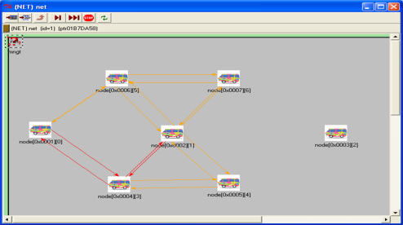

Thales Case Study: Ad-hoc waveform networking protocols
Technical challenges
  Automatic network : no initial planning
  Network continuity whatever are the stations in the network
  “on the move” automatic network re-organization and operation
  End-to-end heterogeneous user services transmission : voice, messages
  Decentralized mesh network. no Base Station
  Nodes collaborate to ensure connectivity and participate in the routing task
Main scope of radio protocol case study: vulnerability analysis based on over-the-air info exchanged at physical layer
  Frames analysis, data alteration, replay, denial of service, tampering and misuse, and combination of the threats

Slide 30


Network threats and vulnerabilities
Detection of potential attacks
  Link spoofing, Data alteration, Flooding attack, Blackhole attack, Denial of service, Replay …
Data alteration
MAC PDU
MAC PDU
header
header
Node A intrusive
Node B

Slide 31
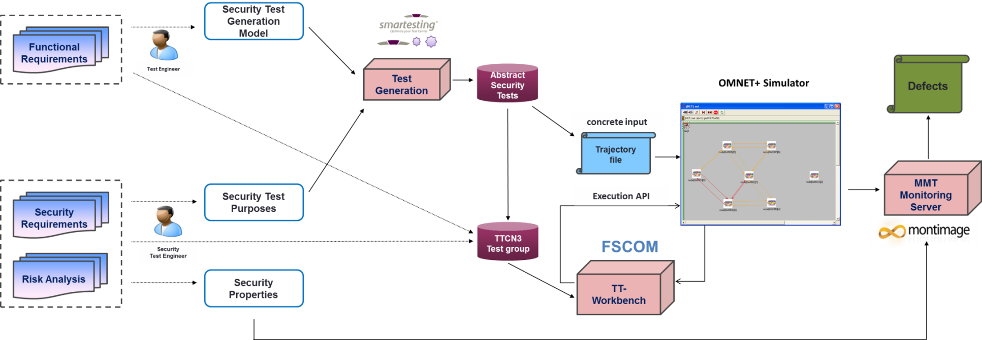
Testing architecture
SMARTESTING
  Security test generation model and test purposes specification
  Generation of test scenarios denoting attacks using Certify-it
FSCOM
  TTCN3 test cases specification
  Test execution using TT-Workbench
MONTIMAGE
  Specification of 19 security properties
  Client /Server architecture
  Notification of exchanged PDUs
  Parsing and extraction of relevant information
  Online analysis of captured PDUs and detection of attacks occurrences

Slide 32
Security Rules Specification : Example
Security requirement: Every node must periodically send a notification message that includes the list of its neighbors on its allocated service slot.
Attack scenario 1: A malicious node sends a message on a non-allocated service slot. This provokes slot reallocation. If done repeatedly, it provokes denial of service.
Specified security properties
  If one node receives two successive MSG_SPHY_DATA_IND messages from the same source, then these two messages must to be separated by 50 slots (Prop 1).
  If one node receives two MSG_SPHY_DATA_IND messages from different sources, then these two messages must have two different slot ids (Prop 2).

Slide 33
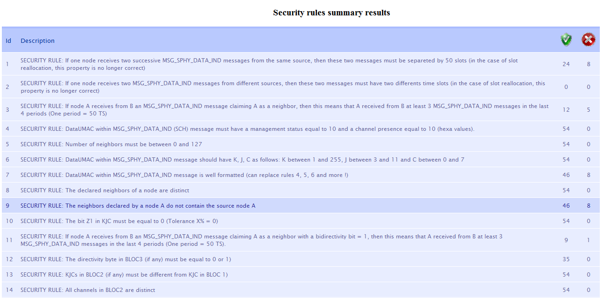
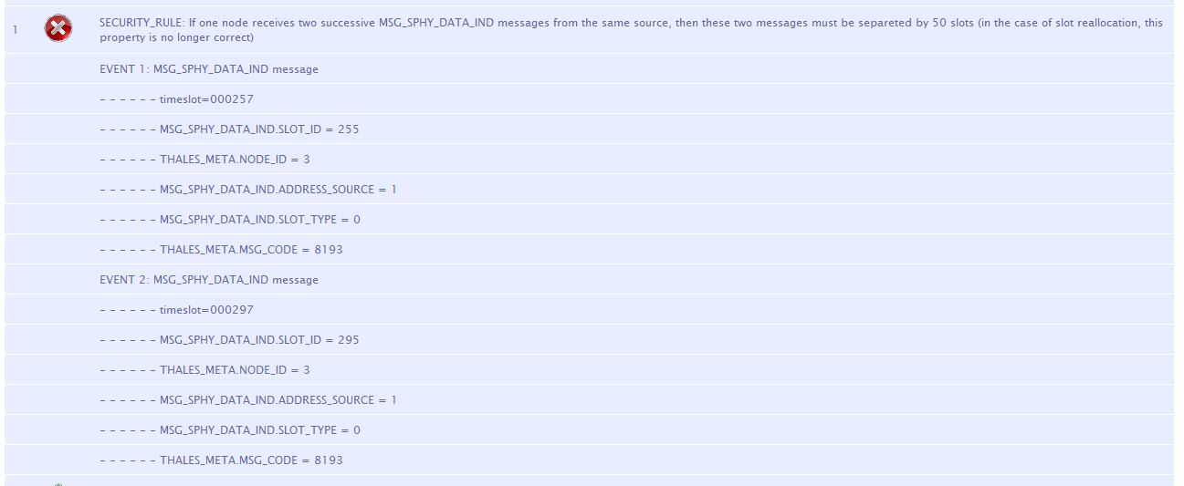
Analysis results: Attack Scenario 1

Slide 34
Some Results
A plugin for “data/fields values” extraction from collected messages has been developed for layer 2 protocols and services.
  More than 20 messages are parsed.
Identification of 5 attack types and generation of different test scenarios simulating intruder nodes.
A set of 19 “security” properties have been specified and checked by Montimage
  Mainly properties dealing with
    the right order of messages
    ensuring availability of specific fields
    ensuring the right structure and length of transmitted messages
At least one security property is violated for each attack occurrence

Slide 35
THANK YOU
Wissam Mallouli
wissam.mallouli@montimage.com

Slide 36
Some of the material used in these slides come from the Internet
Thanks to “them”

