Slide 1
Efficient Multi-Objective Higher Order Mutation Testing with Genetic Programming
W. B. Langdon
University College, London

Slide 2
Introduction
2 objectives: Hard to kill, little change to source
Higher order mutation testing→mutant has more than one change
How we use genetic programming
Results on 4 benchmarks (triangle, schedule, tcas, gzip)
Coupling Hypothesis
Non-Deterministic Mutants
Conclusions

Slide 3
Multi-Objective Search
By extending mutation testing to higher orders we allow mutants to be more complicated, emulating expensive post release bugs which require multiple changes to fix.
To avoid trivial mutants which are detected by many tests we search for hard to kill mutants which pass almost all of the test suite.
Two objectives →Pareto multi-objective search

Slide 4
Evolving High Order Mutants

Slide 5
Evolving High Order Mutants
C source converted to BNF grammar
BNF describes original source plus mutations
All comparisons can be mutated
Strongly Typed GP crosses over BNF to give new high order mutants.
Compile population of mutants to give one executable. Run it on test suite to give fitness.
Select parents of next generation.

Slide 6
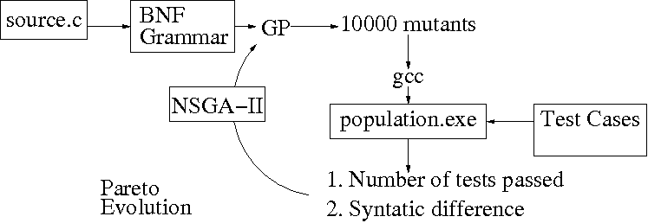

Slide 7
Triangle.c
int gettri(int side1, int side2, int side3){
int triang ;
if( side1 <= 0 || side2 <= 0 || side3 <= 0){
return 4;
}
triang = 0;
if(side1 == side2){
triang = triang + 1;
}
if(side1 == side3){
triang = triang + 2;
}
if(side2 == side3){
triang = triang + 3;
}
if(triang == 0){
if(side1 + side2 < side3 || side2 + side3 < side1 || side1 + side3 < side2){
return 4;
}
else {
Potential mutation sites
(comparisons) in red

Slide 8
Triangle BNF syntax
<line1> ::= "int gettriXXX(int side1, int side2, int side3)\n"
<line2> ::= "{\n"
<line3> ::= " \n"
<line4> ::= "int triang ;\n"
<line5> ::= " \n"
<line6> ::= <line6A> <line6B> <line6C>
<line6A> ::= "if( side1" <compare> "0 || side2"
<line6B> ::= <compare> "0 || side3"
<line6C> ::= <compare> "0){\n"
<line7> ::= "return 4;\n"
<line8> ::= "}\n"
<line9> ::= " \n"
<line10> ::= "triang = 0;\n"
<line11> ::= "\n"
<line12> ::= "if(side1" <compare> "side2){\n"
<line13> ::= "triang = triang + 1;\n"
<line14> ::= "}\n"
<line15> ::= "if(side1" <compare> "side3){\n"
<line16> ::= "triang = triang + 2;\n"
<line17> ::= "}\n"
<line18> ::= "if(side2" <compare> "side3){\n”

Slide 9
Triangle BNF syntax 2
<start> ::= <line1> <line2> <line3> <line4> <line5> <line6-23> <line24-41>
<line42> <line43> <line44> <line45> <line46>
<line6-23> ::= <line6-14> <line15-23>
<line6-14> ::= <line6-9> <line10-12> <line13> <line14>
<line6-9> ::= <line6> <line7> <line8> <line9>
<line10-12> ::= <line10> <line11> <line12>
<line15-23> ::= <line15-19> <line20-23>
<line15-19> ::= <line15-16> <line17-18> <line19>
<line15-16> ::= <line15> <line16>
<compare> ::= <compare0> | <compare1>
<compare0> ::= <compare00> | <compare01>
<compare00> ::= "<" | "<="
<compare01> ::= "==" | "!="
<compare1> ::= <compare10>
<compare10> ::= ">=" | ">”

Slide 10
Yue’s Triangle Test Cases
-3 4 5 4
3 4 5 1
3 -4 5 4
3 4 -5 4
-3 -4 -5 4
3 -4 -5 4
-3 4 -5 4
-3 -4 5 4
-3 5 4 4
3 -5 4 4
5 3 -4 4
5 -3 4 4
3 3 5 2
5 3 5 2
3 4 4 2
3 4 8 4
3 9 5 4
12 4 5 4
4 5 12 4
-4 12 5 4
60 test cases chosen to test all branches in triangle.c
Three integers followed by expected result

Slide 11
Triangle
7 first order mutants are very hard to kill (fail only 1 test).
8 first order mutants are equivalent (pass all)

Slide 12
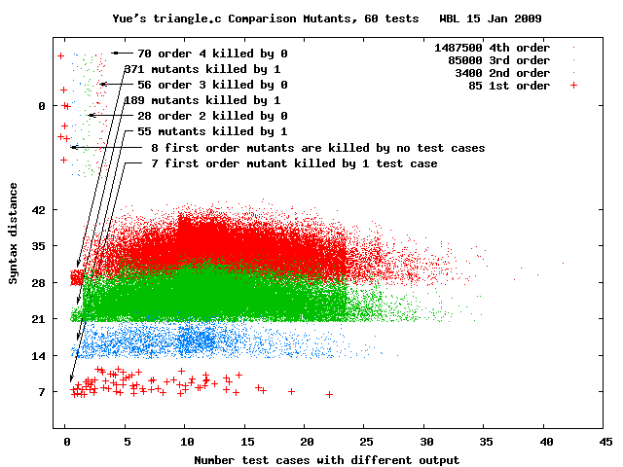
High Order Triangle Mutants

Slide 13
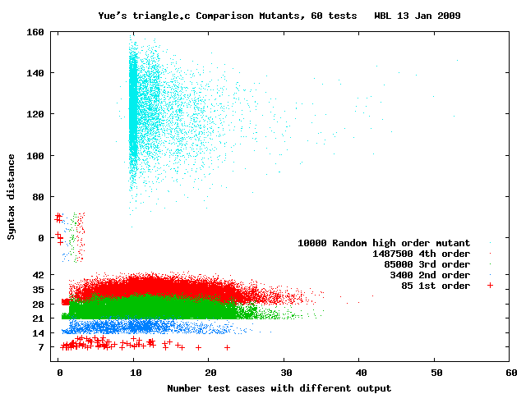
High Order Triangle Mutants
The 10 normal operation tests detect >99% of random mutants

Slide 14
Coupling Hypothesis
“Complex mutants are coupled to simple mutants in such a way that a test data set that detects all simple mutants in a program will also detect a large percentage of the complex mutants.”
─ Richard DeMillo
Plots strengthen this.
Created 16,383 test suites

Slide 15
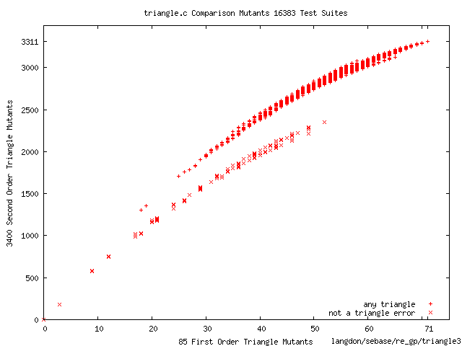
Coupling First and Second Order Mutants
Fraction of 2nd order mutants killed by a triangle test suite strongly correlated to fraction of 1st order mutants it kills.

Slide 16
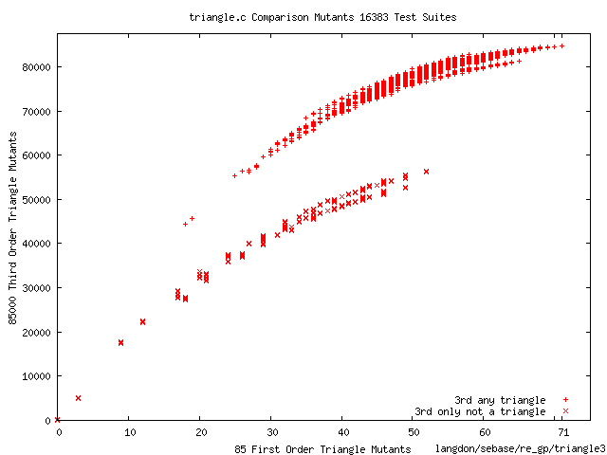
Coupling First and Third Order Mutants
Fraction of third order mutants killed by a triangle test suite is strongly correlated to the fraction of first order mutants it kills.

Slide 17
Competent Programmer Hypothesis
“errors should be detectable as small deviations from the intended program.”
─ Richard DeMillo
Purushothaman and Perry suggest faults that remain after testing are complex.

Slide 18
Schedule
1 first order very hard to kill (only 1 test).
10 first order mutants are equivelent (pass all)

Slide 19
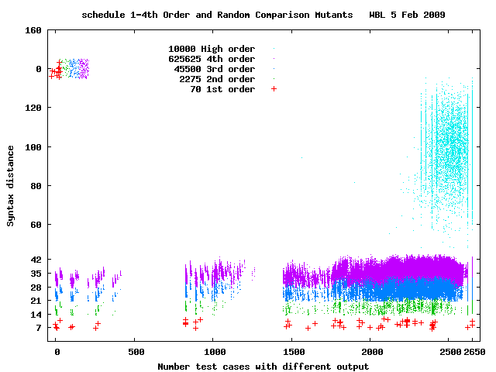
High Order Schedule Mutants

Slide 20
tcas
1 first order hard to kill (only passes 3 tests).
No first order passes only 1 or 2 tests.
24 first order mutants are equivelent (pass all)
As with triangle and schedule, high order tcas mutants (HOM) are easy to kill but show some interesting structure:
428 tests are ineffective against HOM
936 tests are almost ineffective against HOM
264 tests kill almost all HOM. These tests check for aircraft threats.

Slide 21
Evolution of tcas Mutants

Slide 22
Evolved tcas Mutants
GP finds 7th order mutant which is killed by only one test in generation 14.
Fifth order mutant found in generation 44
Second GP run found 4th order (generation 90) and third order mutant (generation 105).
All of these are harder to kill than any first order mutant. They affect similar parts of the code but are not all semantically identical.

Slide 23
Evolved 3rd order tcas Mutant
Changes lines 101, 112, 117:
101 and 117 are silent but 112 fails 12 tests.
Passes all tests except test 1400. Should return 0 but mutant returns DOWNWARD_RA.
Fitness 1,23 (1 tests failed, syntax distance=23).
result = Own_Below_Threat() && (Cur_Vertical_Sep >= MINSEP) && (Down_Separation < =ALIM());
result = Own_Below_Threat() && (Cur_Vertical_Sep >= MINSEP) && (Down_Separation >= ALIM());
return (Own_Tracked_Alt <= Other_Tracked_Alt);
return (Own_Tracked_Alt < Other_Tracked_Alt);
return (Other_Tracked_Alt <= Own_Tracked_Alt);
return (Other_Tracked_Alt < Own_Tracked_Alt);
Line 112 Own_Below_Threat()
Line 117 Own_Above_Threat()

Slide 24
Efficiency Techniques
Problems | Solutions
Comparison of text (including error messages) | Replace printf results and error messages by saving output inside test harness and using status codes
Array indexing errors | Automatic array index checking before all array accesses
Run out of memory or corrupt the heap | Allocate heap memory large enough for all of the test cases
Read or write illegal memory | Automatic pointer checking before it is used.
Compiler overhead | Compile once with ability to select mutants
Non-terminated loops | Loop counter technique to kill mutants
Harmful system calls and IO operations | Record original program's use of system calls and IO by instrumenting the code. Intercept and check system & IO during mutation testing
Heavy disk usage | Combine tests into a single file. A potential alternative might be to use RAM disk
Non-deterministic mutants | Force the initialisation of all variables

Slide 25
gzip
Time to compile. Time to test
Frame work needs to be robust to mutant code:
Time out looping mutants (For and goto)
Protect against invalid array indexes and pointers bgcc −fbounds_checking
Protect against trashing files. Intercept IO and system
Trap exceptions
heavy use of macros and conditional compilation
Avoid mutations changing configuration but allow in .h by operating on source after include/macro expansion. gcc –E

Slide 26
gzip
5680 lines of C. SIR test suite (only 211 tests).
Highly non-uniform testing.
Concentrate on well tested code.

Slide 27
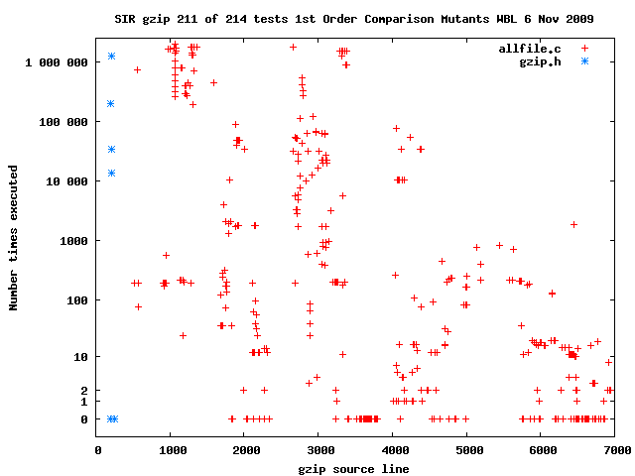
gzip first order mutants
27

Slide 28
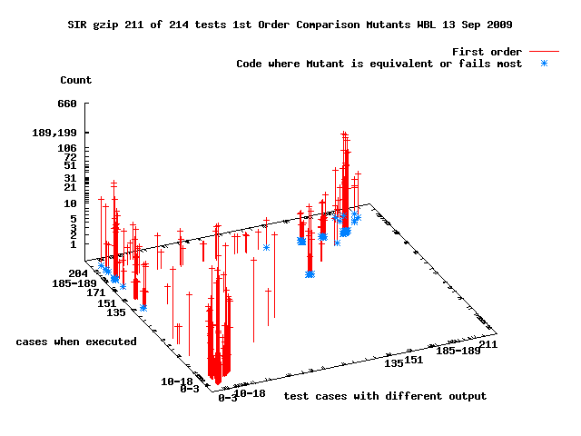
gzip first order mutants
28

Slide 29
gzip well tested code
5680 lines of C. SIR test suite (only 211 tests).
Highly non-uniform testing.
Concentrate on well tested code.
496 1st order mutation sites
84 well tested
78 potentially equivalent
342 fail more than half SIR test suite

Slide 30
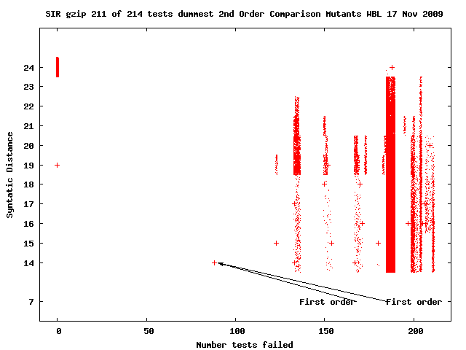
gzip 2nd order sow’s ear mutants
Of 87,150 2nd mutants all except 4 are similar to 1st order.

Slide 31
2nd order interactions of “easy” 1st order
Two easy to kill 1st partially conceal each other
Both in for loop of scan_tree()
if (count < min_count) mutated to <= Fails 89% of tests. Other 1st order is 13 lines later
if (curlen == nextlen) ..else.. mutated to != Causes min_count=3 to be replaced by min_count=4 and vice-versa. Fails more than 99% of tests.
In many tests first line is if(count<4) sometimes with both changes this becomes if(count<=3) and the test is past.

Slide 32
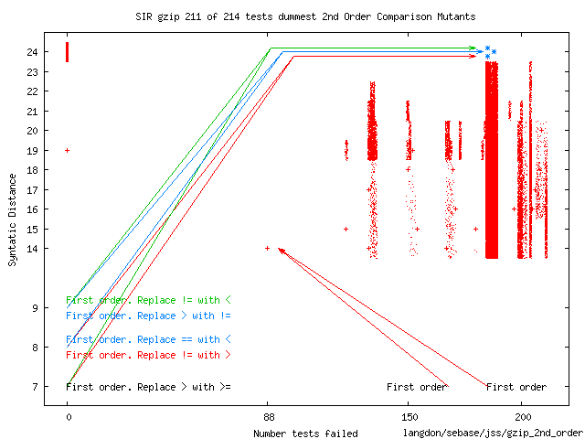
gzip 2nd order sow’s ear mutants
Of 87,150 2nd mutants all except 4 are similar to 1st order.

Slide 33
2nd order interactions of equivelent 1st order
Two equivelent 1st make each other visible
Both mutation sites are in longest_match()
A!= at the start of the outer loop is replaced by < != is partially for efficiency, when 1st order makes a difference it is trapped by if 8 lines later
if(len>best_len) is replaced by (len>= best_len) so the last occurrence of the longest match rather than first is used.
When both changes are made the if no longer traps the effect of < and most tests are failed.

Slide 34
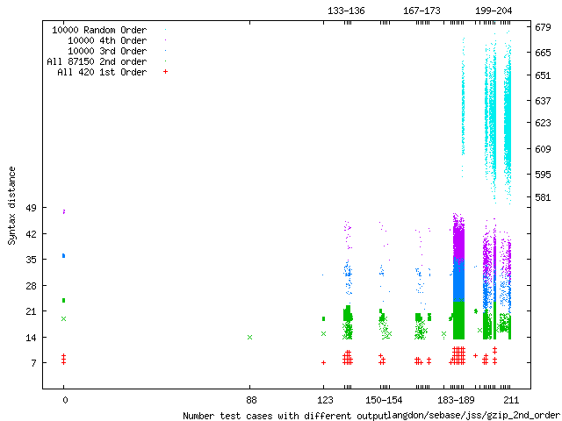
gzip Monte Carlo sample of high order
All but 7 tests highly effective against very high order mutants (as with other benchmarks). 7 in main() or close to it.

Slide 35
Non-Deterministic Mutants
Mutating, even correct code, may cause it to produced different output when run again with the same input. Thus a non-deterministic mutant may or may not be killed by a test suite.
Catching non-repeatable faults by repeated runs is not practical.
Mutation test harness attempts to avoid non-determinism by:
Ensuring all variable are initialised (even in mutated code)
Controlling I/O and system calls.
Avoiding timing problems. Using loop counting, rather than time out, to detect and report indefinite loops.
Avoiding tests which rely on variable details of user input (eg. timing).

Slide 36
Conclusions
Random high order mutants are easy to kill but may provide insight into code and test suite.
Mutation testing can be viewed as multi-objective search.
Genetic programming can find high order mutants which are both hard to kill and do not make too many changes to the original source code.
Evidence for the Coupling Hypothesis
Importance of non-deterministic mutants
Journal of Systems and Software
doi:10.1016/j.jss.2010.07.027

Slide 37
The End !!!

Slide 38
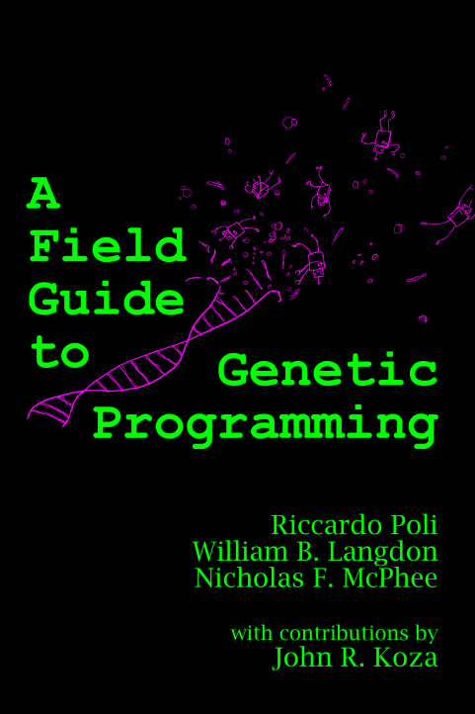
More information on GP
http://www.cs.ucl.ac.uk/staff/W.Langdon
A Field Guide to Genetic Programming, Free, 2008
Foundations of GP, Springer, 2002
GP and Data Structures, Kluwer, 1998

