Slide 1

Evolution metrics for defect prediction: getting help from search based techniques
Sègla KPODJEDO
Ecole Polytechnique de Montreal, alumni
In collaboration with
Giulio Antoniol
Philippe Galinier
Yann-Gael Gueheneuc
Filippo Ricca

Slide 2
Metrics for Defect Prediction
- LOC
- Complexity metrics
- Change metrics
....
Context
Get the info
Diffing artifacts
MADMatch
Data Modeling
Cost Modeling
Solution
Example
Evaluation
Use the info
Which metrics?
Watch List
Evolution Cost
Edit operations
Perspectives
Code churn
#Changes
What about ...

Slide 3
... these evolution facts (class diagram level)?
Split/Extract classes
dns → dns, Type, DClass, Flags, Section, RCode
DNS.WorkerThread → org.xbill.Task.WorkerThread, org.xbill.DNS.ResolveThread
Rename classes
(1.0.2) org.xbill.DNS.TypeClass → (1.1)org.xbill.DNS.TypeClassMap → (1.2.0) TypeMap
Add a new parameter in a method
Zone(String) → Zone(String,int)
lookup(Name,short,short,byte) → lookup(Name,short,short,byte,boolean)
addTCP(short) → addTCP(InetAddress,short)
Remove a parameter of a method
toWireCanonical(CountedDataOutputStream,int) → toWireCanonical(CountedDataOutputStream)
Change a parameter type
setEDNS(boolean) → setEDNS(int)
receiveMessage(int,Message) → receiveMessage(Object,Message)
org.xbill.DNS.Header.setRcode(byte) → org.xbill.DNS.Header.setRcode(short)
addSet(Name,short,Object) → addSet(Name,short,TypedObject)
More complex changes
byte[] rrToWire(Compression,int) → void rrToWire(DataByteOutputStream,Compression)
Rename method
notimplMessage(Message) → errorMessage(Message,short)
findSets(Name,short) → lookup(Name,short)
Rename attribute
DoubleHashMap.s2v → DoubleHashMap.byString, DoubleHashMap.v2s → DoubleHashMap.byInteger
[sometimes reveals structure] private Hashtable h → private Entry [] table
...
Context
Get the info
Diffing artifacts
MADMatch
Data Modeling
Cost Modeling
Solution
Example
Evaluation
Use the info
Which metrics?
Watch List
Evolution Cost
Edit operations
Perspectives
CAN THIS KIND OF INFORMATION HELP DEFECT PREDICTION?
HOW DO WE GET THAT INFORMATION?
HOW DO WE USE IT?

Slide 4

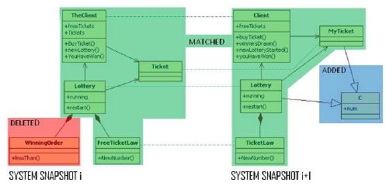
How to get the information.
In the general case,
Reverse engineer the diagrams and “diff” them
Context
Get the info
Diffing artifacts
MADMatch
Data Modeling
Cost Modeling
Solution
Example
Evaluation
Use the info
Which metrics?
Watch List
Evolution Cost
Edit operations
Perspectives
Xing et al. UMLDiff [TSE, 2005]
Mandelin et al. [TSE, 2010]
EMFCompare A tool used in industry
...
PADL (Gueheneuc et. al [ICSM, 2004])
AOL (Antoniol et. al)
...
Limitations of existing work:
Scalability, Accuracy, Scope of applicability
The second diagram is the result of edit operations appplied to the first.
Costs are assigned to the operations
→ Optimisation problem
find the cheapest transformation.
Our solution: a Tabu Search
enhanced by lexical information
Example

Slide 5
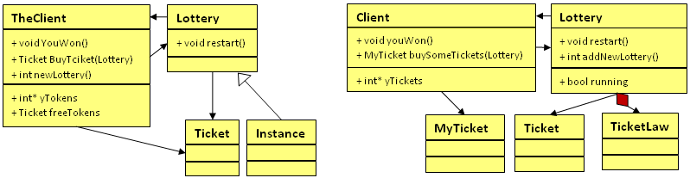
Running example
Context
Get the info
Diffing artifacts
MADMatch
Data Modeling
Cost Modeling
Solution
Example
Evaluation
Use the info
Which metrics?
Watch List
Evolution Cost
Edit operations
Perspectives
Find the differences!!
1) the class TheClient was renamed into Client;
2) the class Ticket was split into classes MyTicket and Ticket;
3) the method newLottery was moved from the class Client to the class Lottery and renamed addNewLottery;
4) the method BuyTciket was renamed buySomeTickets;
5) the attribute yTokens was renamed yTickets;
6) the method YouWon was renamed youWon;
7) the class Instance was deleted;
8) a new class TicketLaw was added;
9) the attribute freeTokens was deleted;
10) a new attribute running was inserted (in Lottery).

Slide 6
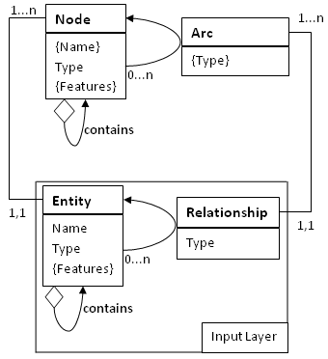
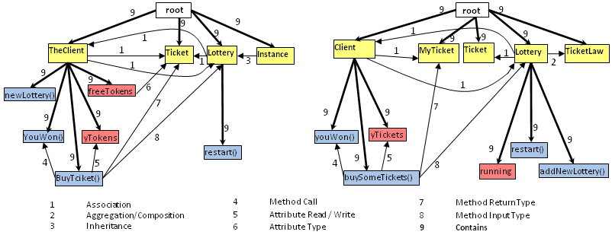
Data Modeling
Context
Get the info
Diffing artifacts
MADMatch
Data Modeling
Cost Modeling
Solution
Example
Evaluation
Use the info
Which metrics?
Watch List
Evolution Cost
Edit operations
Perspectives
Entity
label: <type, name, feats>
Relatioship
<type>
contains (type 9)

Slide 7
Cost modeling
Basic Model
Cost Basic Edit Operation
c_{nlm} Matching of two nodes with different labels (depends on their similarity)
c_{nd} Deletion of a node from G₁
c_{ni} Insertion of a node in G₂
c_{amd} Deletion of an arc between two matched nodes from G₁
c_{ami} Insertion of an arc between two matched nodes in G₂
c_{aud} Deletion of an arc between two nodes, of which at least one is deleted
c_{aui} Insertion of an arc between two nodes, of which at least one is inserted
Context
Get the info
Diffing artifacts
MADMatch
Data Modeling
Cost Modeling
Solution
Example
Evaluation
Use the info
Which metrics?
Watch List
Evolution Cost
Edit operations
Perspectives
High Level setting
Control Error-Tolerance
Control contribution of different information
Address direction of matching

Slide 8



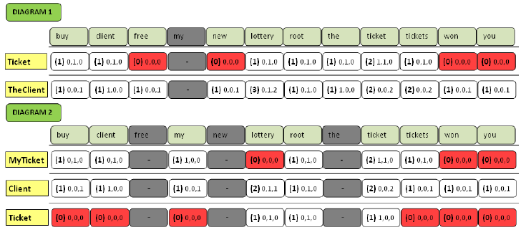
Solution overview
Tabu Search
Context
Get the info
Diffing artifacts
MADMatch
Data Modeling
Cost Modeling
Solution
Example
Evaluation
Use the info
Which metrics?
Watch List
Evolution Cost
Edit operations
Perspectives
Exploiting textual information
Key idea borrowed from litterature: Identifier splitting
Selected Technique: CamelCase Split
ex:drawVerticalLabel → {draw,vertical,label}
Label dissimilarity computation
Search initialisation
Search space reduction
Entity Termal footprint
Entity Term Matrix
TheClient
Lottery
newLottery()

Slide 9
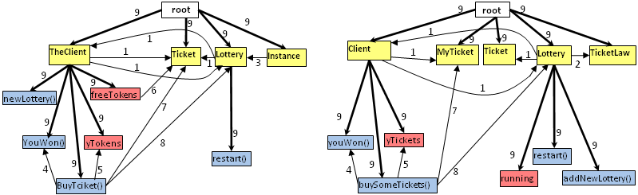
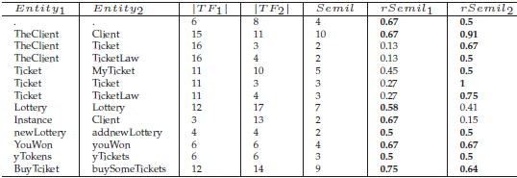
MADMatch in Motion
Empty solution [1156]
root↔root, Ticket↔Ticket, Lottery↔Lottery, restart↔restart [809]
Tabu Search (only contextually similar pairs are considered)
  TheClient ↔ Client -86 [723]
  TheClient.YouWon() ↔ Client.youWon() -84 [639]
  TheClient.BuyTciket() ↔ Client.buySomeTickets() -65 [574]
  Ticket ↔ MyTicket (Merge of Ticket and MyTicket) -48 [526]
  TheClient.newLottery() ↔ Lottery.addNewLottery() -44 [482]
  TheClient.yTokens ↔ Client.yTickets -41 [441]
  TheClient ↔ TicketLaw (Merge of Ticket and TicketLaw) +55 [496]
Context
Get the info
Diffing artifacts
MADMatch
Data Modeling
Cost Modeling
Solution
Example
Evaluation
Use the info
Which metrics?
Watch List
Evolution Cost
Edit operations
Perspectives

Slide 10
Empirical Evaluation
Context
Get the info
Diffing artifacts
MADMatch
Data Modeling
Cost Modeling
Solution
Example
Evaluation
Use the info
Which metrics?
Watch List
Evolution Cost
Edit operations
Perspectives

Slide 11
MADMatch Results
  Compared Accuracy of MADMatch(M) and UMLDIFF (U)
  Differential precision: 78-100% (M), 42-63% (U)
  Differential Recall: 74-100% (M), 0-26% (U)
  Compared Accuracy of MADMatch(M) and AURA (A)
  Differential precision: 69% (M), 33% (A)
  Differential Recall: 74% (M) 26% (A)
  Also, MADMatch
  Is more accurate than PLTSDIFF for Labeled Transition Systems
  Gets 100% Accuracy on the tested sequence diagrams
  Faster than UMLDiff (7-20 times) and AURA (4-12 times)
  Scalable to Eclipse (94,000 to 226,000 entities) in 3-9 hours
Context
Get the info
Diffing artifacts
MADMatch
Data Modeling
Cost Modeling
Solution
Example
Evaluation
Use the info
Which metrics?
Watch List
Evolution Cost
Edit operations
Perspectives
For more details | Conferences | Journals | Synthesis in archival journals
Meta-Heuristics | [EvoCOP2010] | [ENDM2010] | DAM [Revision]
Software Engineering | [WCRE2008] [CSMR2009] | [JSME2010] | TSE [Soon Submitted]
Online tool available at http://tools.soccerlab.polymtl.ca/madmatch

Slide 12
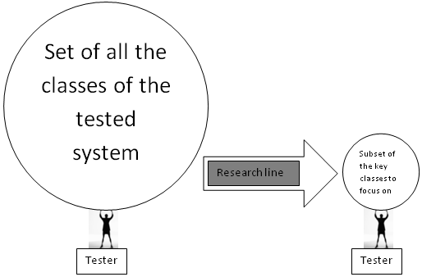
How to use the evolution information
GOAL
METRICS
Evolution Cost
Cumulative cost of all edit
operations applied on a class
Basic Edit operations
Count
Context
Get the info
Diffing artifacts
MADMatch
Data Modeling
Cost Modeling
Solution
Example
Evaluation
Use the info
Which metrics?
Watch List
Evolution Cost
Edit operations
Perspectives
 | Raw Use | Predictive Models
Evolution Cost | [RSSE2008] | [SSBSE2009]
Basic Operations | To Do. [CSMR2011] | [EMSE2010]

Slide 13
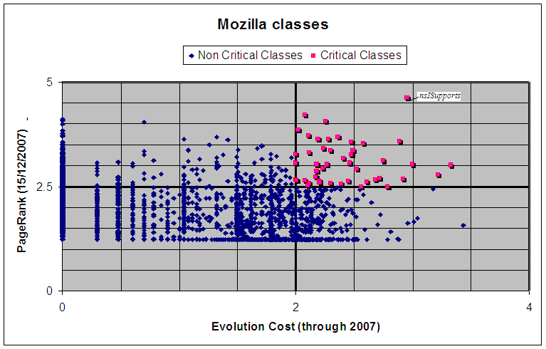
[RSSE2008]: Build a Watch List
A simple 2D Grid: Evolution Cost and PageRank value
Context
Get the info
Diffing artifacts
MADMatch
Data Modeling
Cost Modeling
Solution
Example
Evaluation
Use the info
Which metrics?
Watch List
Evolution Cost
Edit operations
Perspectives

Slide 14
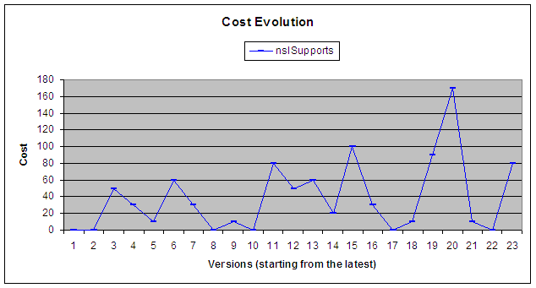
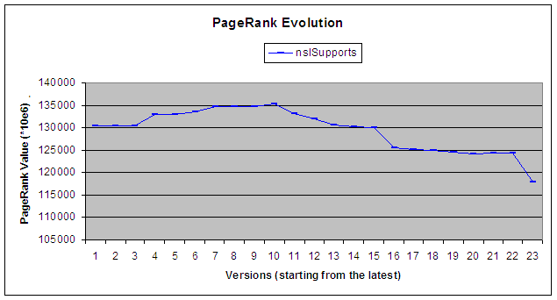
[SSBSE2009]: EC in predictive models
Linear Regression
Logistic Regresion
Classification and Regression Trees (CART)
Context
Get the info
Diffing artifacts
MADMatch
Data Modeling
Cost Modeling
Solution
Example
Evaluation
Use the info
Which metrics?
Watch List
Evolution Cost
Edit operations
Perspectives
Moderate improvement with respect to C&K metrics

Slide 15
Basic Design Evolution Metrics
For a given class
Context
Get the info
Diffing artifacts
MADMatch
Data Modeling
Cost Modeling
Solution
Example
Evaluation
Use the info
Which metrics?
Watch List
Evolution Cost
Edit operations
Perspectives
 | Added | Modified | Deleted
Methods | nbAddMeth | nbModMeth | nbDelMeth
Attributes | nbAddAttr | nbModAttr | nbDelAttr
In-Relations | nbAddInRel | nbModInRel | nbDelInRel
Out-Relations | nbAddOutRel | nbModOutRel | nbDelOutRel

Slide 16
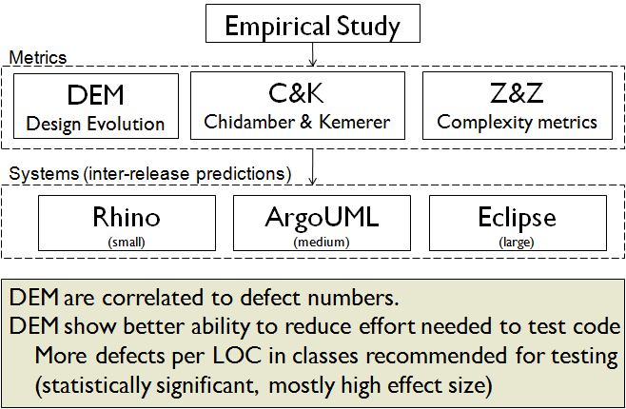
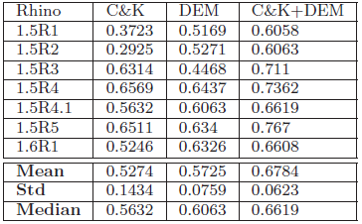
Empirical evaluation [EMSE2010]
Context
Get the info
Diffing artifacts
MADMatch
Data Modeling
Cost Modeling
Solution
Example
Evaluation
Use the info
Which metrics?
Watch List
Evolution Cost
Edit operations
Perspectives
Adjusted R² from linear
regressions on Rhino

Slide 17
Future Work and Perspectives
Collect raw post-mortem data on mid-level operations
Context
Get the info
Diffing artifacts
MADMatch
Data Modeling
Cost Modeling
Solution
Example
Evaluation
Use the info
Which metrics?
Watch List
Evolution Cost
Edit operations
Perspectives
y₁
y₂
y₁
y₂
a
b
a
b
u₂
u₁
x₂
...
x₁
x₂
x₁
v₁
v₂
w₂
w₁
Related ideas
and algorithms
[CSMR11]
Risky?
modified: 134 / 452
reverted: 86
Risky?
modified: 64/76
reverted: 57
Investigate renaming consistency and impact.
Long-term Goal:
A tool reporting such raw information on demand or as soon as “risky” mid-level operations are applied.

Slide 18
THANKS FOR YOUR ATTENTION!
QUESTIONS?

Slide 19
Related work
BINKLEY, D., DAVIS, M., LAWRIE, D. and MORRELL, C. (2009). To camelcase or under score. ICPC. 158–167.
BOGDANOV, K. and WALKINSHAW, N. (2009). Computing the structural difference between state-based models. WCRE. 177–186.
KIMELMAN, D., KIMELMAN, M., MANDELIN, D., YELLIN, D. (2010). Bayesian Approaches to Matching Architectural Diagrams. IEEE Trans. Software Eng. 36(2): 248-274
KUHN, H. (1955). The hungarian method for the assignment problem. Naval Research Logistics Quarterly, 2, 83–97.
RAYMOND, J., GARDINER, E. and WILLETT, P. (2002). Rascal : calculation of graph similarity using maximum common edge subgraphs. Computer Journal, 45, 631–44.
RIESEN, K. and BUNKE, H. (2009). Approximate graph edit distance computation by means of bipartite graph matching. Image and Vision Computing, 27, pp.950–959.
ROBINSON, W. N. and WOO, H. G. (2004). Finding reusable uml sequence diagrams automatically. IEEE Software, 21, 60–67.
WU, W., GUEHENEUC, Y.-G., ANTONIOL, G. and KIM, M. (2010). Aura : a hybrid approach to identify framework evolution. ICSE (1). 325–334.
XING, Z. (2010) Model comparison with GenericDiff. ASE. 135-138
XING, Z. and STROULIA, E. (2005a). Analyzing the evolutionary history of the logical design of object-oriented software. IEEE Trans. Software Eng. 31, 850–868.
ZASLAVSKIY, M., BACH, F. and VERT, J.-P. (2009). A path following algorithm for the graph matching problem. IEEE Trans. on Patt. Anal. and Mach. Int., 31, 2227–2242.
ZIMMERMANN, T., PREMRAJ, R. and ZELLER, A. (2007). Predicting defects for eclipse. Proceedings of the Third International Workshop on Predictor Models in Software Engineering.

Slide 20
Publications (Graph & Diagram Matching, Defect prediction)
KPODJEDO, S., GALINIER, P. and ANTONIOL, G. (2010a). Enhancing a tabu algorithm for approximate graph matching with a similarity measure. EvoCOP’10, 119–130.
KPODJEDO, S., GALINIER, P. and ANTONIOL, G. (2010b). On the use of local similarity measures for approximate graph matching. Electronic Notes in Discrete Mathematics, 36, 687–694.
KPODJEDO, S., RICCA, F., ANTONIOL, G. and GALINIER, P. (2009a). Evolution and search based metrics to improve defects prediction. Search Based Software Engineering, International Symposium on, 23–32.
KPODJEDO, S., RICCA, F., GALINIER, P. and ANTONIOL, G. (2008a). Error correcting graph matching application to software evolution. Proc. of the Working Conference on Reverse Engineering.
KPODJEDO, S., RICCA, F., GALINIER, P. and ANTONIOL, G. (2008b). Not all classes are created equal : toward a recommendation system for focusing testing. RSSE ’08. 6–10.
KPODJEDO, S., RICCA, F., GALINIER, P. and ANTONIOL, G. (2009b). Recovering the evolution stable part using an ECGM algorithm : Is there a tunnel in mozilla ? CSMR’09, 179–188.
KPODJEDO, S., RICCA, F., GALINIER, P., ANTONIOL, G. and GUEHENEUC, Y.-G. (2010c). Studying software evolution of large object-oriented software systems using an etgm algorithm. Journal of Software Maintenance and Evolution, http ://dx.doi.org/10.1002/smr.519.
KPODJEDO, S., RICCA, F., GALINIER, P., GUEHENEUC, Y.-G. and ANTONIOL, G. (2011). Design evolution metrics for defect prediction in object oriented systems. Empirical Software Engineering, 16, 141–175.
BELDERRAR, A., KPODJEDO, S., GUEHENEUC, Y.-G. , ANTONIOL, G., GALINIER:, P. (2011) Sub-graph Mining: Identifying Micro-architectures in Evolving Object-Oriented Software. CSMR 2011: 171-180
[REVISION] Using Local Similarity Measures to efficiently address Approximate Graph Matching, Discrete Apllied Mathematics
[SOON SUBMITTED] MADMatch: a generic Many-to-many Approximate Diagram Matching Approach for Software Engineering, Trans. Software Engineering

Slide 21
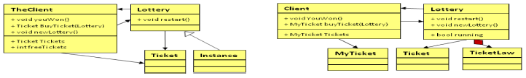
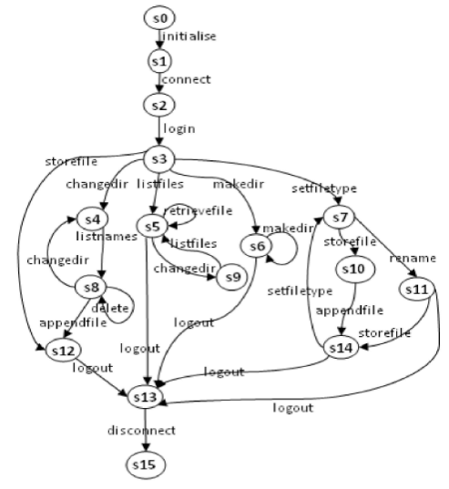
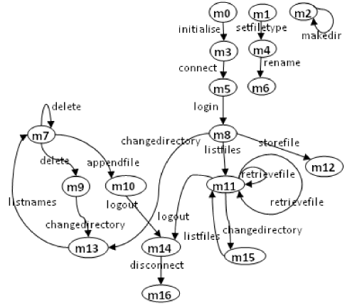
Diagram matching in SE (1)
UMLDiff ...
(OO Design Evolution)
AURA...
(API Evolution)
PLTSDiff
Etc.
REUSER
To each specific problem and diagram, its dedicated approaches

Slide 22
Diagram matching in SE (1I)
MADMatch

