Slide 1




Subgroup Discovery in Defect Prediction
Rachel Harrison, Oxford Brookes University
Daniel Rodríguez, Univ of Alcala
José Riquelme, Univ of Seville
Roberto Ruiz, Pablo de Olavide University

Slide 2
Outline
Supervised Description
Subgroup Discovery
Preliminary Experimental Work
  Datasets
  Algorithms (SD and CN2-SD)
  Results
Conclusions and future work

Slide 3
Descriptive Models
Typically, ML algorithms have been divided into:
  Predictive (Classification, Regression, temporal series)
  Descriptive (Clustering, Association, summarisation)
Recently, supervised descriptive rule discovery is being introduced in the literature.
  The aim is to understand the underlying phenomena, not to classify new instances, i.e., to find information about a specific value in the class attribute.
  The information should be useful to the domain expert and easily interpretable.
  Types of supervised descriptive techniques include:
    Contrast Set Mining (CSM)
    Emerging Pattern Mining (EPM)
    Subgroup discovery (SD)

Slide 4
SD – Definition
SD algorithms aims to find subgroups of data that are statistically different given a property of interest. [Klösgen, 96; Wrobel, 97]
  SD lies between predictive (finding rules given historical data and a property of interest) and descriptive tasks (discovering interesting patterns in data).
  SD algorithms generally extract rules from subsets of the data, having previously specified the concept, for example defective modules from a software metrics repository.
  Rules have also the "Condition → Class" where the condition is the conjunction of a set of selected variables (pairs attribute–value) among all variables.
    Advantages of rules include that they are well known representations easily understandable by the domain experts
  So far, SD has mostly been applied to the medical domain.

Slide 5
SD vs. Classification
 | Classification | Subgroup Discovery
Induction | Predictive | Descriptive
Output | Set of classification rules (dependent rules) | Individual Rules to describe subgroups (independent rules)
Purpose | To learn a model for classification or prediction | To find interesting and interpretable patterns with respect to a specific attribute

Slide 6
SD vs. Classification
Following [Herrera et al, 2011]

Slide 7
SD Algorithms
SD algorithms could be classified as:
  Exhaustive (e.g.: SD-map, Apriori-SD)
  Heuristic (e.g.: SD, CN2-SD)
    Fuzzy genetic algorithms (SDIGA, MESDIF, EDER-SD)
Or from their origin, evolved from different communities:
  Extension of classification algorithms (SD, CN2-SD, etc.)
  Extension of association algorithms (Apriori-SD, SD4TS, SD-Map, etc.)
Comprehensive survey by [Herrera et al. 2011]

Slide 8

Quality Measures in SD
Measures of Complexity
  Number of rules: It measures the number of induced rules.
  Number of conditions: It measures the number of conditions in the antecedent of the rule.
Measures of Generality
  Coverage: $Cov\left(R\right)=\frac{n(Cond)}{N}$
    where N is the number of samples and n(Cond) is the no. of instances that satisfy the antecedent of the rule.
  Support: $Sup\left(R\right)=\frac{n(Cond·Class)}{N}$
    where n(Cond · Class) is the no. of instances that satisfy both the condition and the class

Slide 9


Quality Measures in SD
Measures of precision
  Confidence: $Conf\left(R\right)=\frac{n(Cond·Class)}{n(Cond)}$
  Precision Q_{c} : $Q_{c}=n\left(Class·Cond\right)−c n(¬Class·Cond)$
  Precision Q_{g} : $Q_{g}= \frac{n(Class·Cond)}{n\left(¬Class·Cond\right)+g}$
Measures of interest
  Significance:
$$Sig\left(R\right)=2 \sum_{k=1}^{n}{n\left(cond·{Class}_{k}\right)·log\frac{n(Cond·{Class}_{k})}{n\left({Class}_{k}\right)·p(Cond)}}$$

Slide 10




Other Measures
$Sens\left(R\right)=TPr= \frac{TP}{Pos}= \frac{n(Class·Cond)}{n(Class)}$
Sensitivity:
False alarm:
Specificity:
Unusualness:
$$FA\left(R\right)=FPr=\frac{FP}{Neg}=\frac{n(¬\overline{Class}Class·Cond)}{n(¬Class)}$$
$$Spec\left(R\right)=\frac{TN}{TN+FP}=\frac{TN}{Neg}=\frac{n(¬Class·¬Cond)}{n(¬Class)}$$
$WRAcc \left(R\right)= \frac{n(Cond)}{N}=\left(\frac{n(Class·Cond)}{n(Cond)}−\frac{n(Class)}{N}\right)$

Slide 11
Experimental Work – Datasets
NASA Datasets
  Originally available from:
    http://mdp.ivv.nasa.gov/
  From PROMISE, using the ARFF format (Weka – data mining toolkit):
    http://promisedata.org/
      Boetticher, T. Menzies, T. Ostrand, Promise Repository of Empirical Software Engineering Data, 2007.
Bug prediction dataset
    http://bug.inf.usi.ch/
      D'Ambros, M., Lanza, M., Robbes, Romain, Empirical Software Engineering (EMSE), In press, 2011

Slide 12
Datasets Characteristics
Some of these datasets are highly unbalanced, with duplicates and contradictory instances, and irrelevant attributes for defect prediction.
 | # inst | Non-def | Def | % Def | Lang
CM1 | 498 | 449 | 49 | 9.83 | C
KC1 | 2,109 | 1,783 | 326 | 15.45 | C++
KC2 | 522 | 415 | 107 | 20.49 | C++
KC3 | 458 | 415 | 43 | 9.39 | Java
MC2 | 161 | 109 | 52 | 32.29 | C++
MW1 | 434 | 403 | 31 | 7.14 | C++
PC1 | 1,109 | 1,032 | 77 | 6.94 | C
Eclipse JDT Core | 997 | 791 | 206 | 20.66 | Java
Eclipse PDE-UI | 1,497 | 1,288 | 209 | 13.96 | Java
Equinox | 324 | 195 | 129 | 39.81 | Java
Lucene | 691 | 627 | 64 | 9.26 | Java
Mylyn | 1,862 | 1,617 | 245 | 13.15 | Java

Slide 13
Metrics Used from the Datasets
For the NASA datasets:
For the OO datasets:
 | Metric | Definition
McCabe | loc | McCabe's Lines of code
 | v(g) | Cyclomatic complexity
 | ev(g) | Essential complexity
 | iv(g) | Design complexity
Halstead | uniqOp | Unique operators, n₁
 | uniqOpnd | Unique operands, n₂
 | totalOp | Total operators, N₁
 | totalOpnd | Total operands N₂
Branch | branchCount | No. branches of the flow graph
Class | defective? | Reported defects? (true/false)
 | Metric | Definition
C&K | wmc | Weighted Method Count
 | dit | Depth of Inheritance Tree
 | cbo | Coupling Between Objects
 | noc | No. of Children
 | lcom | Lack of Cohesion in Methods
 | rfc | Response For Class
Class | defective? | Reported defects?

Slide 14

Algorithms
The algorithms used:
  The Subgroup Discovery algorithm (SD) [Gamberger, 02] is a covering rule induction algorithm that using beam search aims to find rules that maximise:
  $q_{g}=\frac{TP}{FP+g}$
    where TP and FP are the number of true and false positives respectively and g is a generalisation parameter that allow us to control the specificity of a rule, i.e., balance between the complexity of a rule and its accuracy.
  The CN2-SD [Lavrac, 04] algorithm is an adaptation of the CN2 classification rule algorithm [Clark, 89]. It induces subgroups in the form of rules using as a quality measure the relation between true positives and false positives. The original algorithm consists of a search procedure using beam search within a control procedure and the control procedure that iteratively performs the search.
    The CN2-SD algorithm uses Weighted Relative Accuracy (explained next) as a covering measure of the quality of the induced rules.
Tool:
  Orange: http://orange.biolab.si/

Slide 15
Examples Rules – KC2 Dataset
 | # | pd | pf | TP | FP | Rules
SD | 0 | .24 | 0 | 26 | 0 | ev(g) > 4 ˄ totalOpnd > 117
 | 1 | .28 | .01 | 30 | 5 | iv(G) > 8 ˄ uniqOpnd > 34 ˄ ev(g) > 4
 | 2 | .27 | .01 | 29 | 5 | loc > 100 ˄ uniqOpnd > 34 ˄ ev(g) > 4
 | 3 | .27 | .01 | 29 | 5 | loc > 100 ˄ iv(G) > 8 ˄ ev(g) > 4
 | 4 | .27 | .01 | 29 | 5 | loc > 100 ˄ iv(G) > 8 ˄ totalOpnd > 117
 | 5 | .24 | .01 | 26 | 5 | iv(G) > 8 ˄ uniqOp > 11 ˄ totalOp > 80
 | 6 | .24 | .01 | 26 | 5 | iv(G) > 8 ˄ uniqOpnd > 34
 | 7 | .23 | .01 | 25 | 5 | totalOpnd > 117
 | 8 | .31 | .01 | 34 | 5 | loc > 100 ˄ iv(G) > 8
 | 9 | .29 | .01 | 32 | 5 | ev(g) > 4 ˄ iv(G) > 8
 | 10 | .29 | .01 | 32 | 5 | ev(g) > 4 ˄ uniqOpnd > 34
 | 11 | .28 | .01 | 30 | 5 | loc > 100 ˄ ev(g) > 4
 | 12 | .28 | .01 | 30 | 5 | iv(G) > 8 ˄ uniqOp > 11
 | 13 | .35 | .01 | 38 | 5 | ev(g) > 4 ˄ totalOp > 80 ˄ v(g) > 6 ˄ uniqOp > 11
 | 14 | .27 | .01 | 29 | 5 | iv(G) > 8 ˄ totalOp > 80
 | 15 | .27 | .01 | 29 | 5 | ev(g) > 4 ˄ totalOp > 80 ˄ uniqOp > 11
 | 16 | .26 | .01 | 28 | 5 | ev(g) > 4 ˄ totalOp > 80 ˄ v(g) > 6
 | 17 | .26 | .01 | 28 | 5 | loc > 100 ˄ uniqOpnd > 34
 | 18 | .31 | .01 | 34 | 5 | ev(g) > 4 ˄ totalOp > 80
 | 19 | .31 | .01 | 34 | 5 | iv(G) > 8
CN2-SD | 0 | .35 | .01 | 38 | 5 | uniqOpnd > 34 ˄ ev(g) > 4
 | 1 | .4 | .02 | 43 | 9 | totalOp > 80 ˄ ev(g) > 4
 | 2 | .78 | .21 | 84 | 88 | uniqOP>11

Slide 16
Example Rules – JDT Core Dataset
 | # | pd | pf | TP | FP | Rules
SD | 0 | .27 | .02 | 56 | 16 | lcom > 171 ˄ rfc > 88 ˄ cbo > 16 ˄ wmc > 141
 | 1 | .3 | .02 | 62 | 16 | rfc > 88 ˄ wmc > 141 cbo > 16
 | 2 | .3 | .02 | 62 | 16 | cbo > 16 ˄ wmc > 141
 | 3 | .29 | .02 | 60 | 16 | lcom > 171 ˄ rfc > 88 ˄ wmc > 141
 | 4 | .29 | .02 | 60 | 16 | lcom > 171 ˄ wmc > 141
 | 5 | .33 | .03 | 68 | 24 | rfc > 88 ˄ wmc > 141
 | 6 | .32 | .03 | 66 | 24 | rfc > 88 ˄ wmc > 141 ˄ dit≤ 5
 | 7 | .33 | .03 | 68 | 24 | wmc > 141
 | 8 | .32 | .03 | 66 | 24 | dit <= 5 ˄ wmc > 141
 | 9 | .18 | .02 | 38 | 16 | wmc > 141 ˄ noc = 0 ˄ dit≤ 5
 | 10 | .19 | .02 | 40 | 16 | wmc > 141 ˄ noc = 0
 | 11 | .18 | .02 | 38 | 16 | cbo > 16 ˄ rfc > 88 ˄ noc > 0 dit≤ 5
 | 12 | .42 | .04 | 87 | 32 | cbo > 16 ˄ rfc > 88 ˄ dit≤ 5
 | 13 | .3 | .03 | 62 | 24 | lcom > 171 ˄ rfc > 88 ˄ cbo > 16 ˄ dit≤ 5
 | 14 | .2 | .02 | 42 | 16 | cbo > 16 ˄ rfc > 88 ˄ noc > 0
 | 15 | .24 | .03 | 50 | 24 | cbo > 16 ˄ rfc > 88 ˄ noc = 0 ˄ dit≤ 5
 | 16 | .45 | .05 | 93 | 40 | cbo > 16 ˄ rfc > 88
 | 17 | .32 | .03 | 66 | 24 | lcom > 171 ˄ rfc > 88 ˄ cbo > 16
 | 18 | .25 | .03 | 52 | 24 | cbo > 16 ˄ rfc > 88 ˄ noc = 0
 | 19 | .33 | .05 | 68 | 40 | cbo > 16 ˄ lcom > 171
CN2-SD | 0 | .45 | .05 | 93 | 40 | rfc > 88 ˄ cbo > 16
 | 1 | .55 | .09 | 114 | 72 | rfc > 88

Slide 17
Cross-validation Results (10 CV)
 |  | Cov | Sup | Size | Cplx | Sig | RAcc | Acc | AUC
SD | CM1 | .233 | .72 | 20 | 3.045 | 4.548 | .029 | .602 | .748
 | KC1 | .079 | .426 | 20 | 2.61 | 16.266 | .023 | .61 | .657
 | KC2 | .085 | .533 | 20 | 2.185 | 9.581 | .049 | .703 | .74
 | KC3 | .294 | .91 | 20 | 2.435 | 5.651 | .037 | .608 | .83
 | MC2 | .161 | .647 | 20 | 2.055 | 2.204 | .042 | .643 | .689
 | MW1 | .071 | .5 | 20 | 2.515 | 3.767 | .02 | .736 | .678
 | PC1 | .118 | .37 | 20 | 3.515 | 3.697 | .01 | .66 | .621
CN2-SD | CM1 | .113 | .64 | 5 | 1.3 | 2.972 | .023 | .628 | .617
 | KC1 | .107 | .607 | 5 | 1.1 | 2.912 | .03 | .634 | .71
 | KC2 | .156 | .795 | 5 | 1.6 | 11.787 | .065 | .733 | .816
 | KC3 | .126 | .885 | 4.9 | 1.295 | 3.146 | .019 | .68 | .797
 | MC2 | .152 | .427 | 5 | 2.32 | 2.186 | .04 | .593 | .593
 | MW1 | .079 | .558 | 5 | 2.02 | 3.517 | .02 | .661 | .743
 | PC1 | .087 | .661 | 5 | 1.86 | 2.814 | .007 | .632 | .688
SD | JDT Core | .082 | .539 | 20 | 2.485 | 13.774 | .039 | .662 | .726
 | PDE UI | .11 | .407 | 20 | 3.94 | 1.936 | .023 | .603 | .642
 | Equinox | .269 | .899 | 20 | 2.08 | 4.577 | .054 | .62 | .759
 | Lucene | .106 | .579 | 20 | 2.295 | 4.368 | .017 | .741 | .696
 | Mylyn | .104 | .425 | 20 | 2.9 | 12.631 | .021 | .675 | .633
CN2-SD | JDT Core | .121 | .543 | 5 | 1.58 | 18.961 | .055 | .613 | .732
 | PDE-UI | .144 | .593 | 3.7 | 2.89 | 1.106 | .023 | .575 | .684
 | Equinox | .166 | .797 | 5 | 1.020 | 3.772 | .043 | .636 | .712
 | Lucene | .070 | .405 | 5 | 2.2 | 4.378 | .016 | .584 | .653
 | Mylyn | .081 | .376 | 4.5 | 2.818 | 11.062 | .018 | .555 | .632

Slide 18
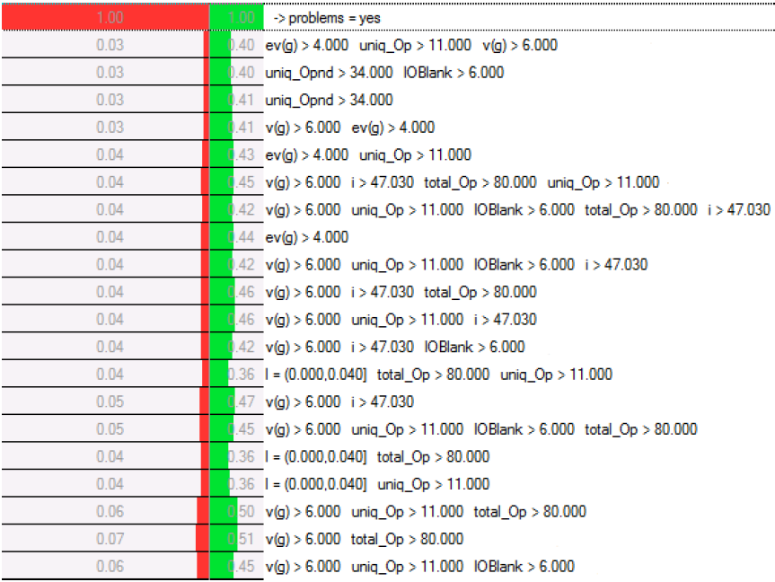
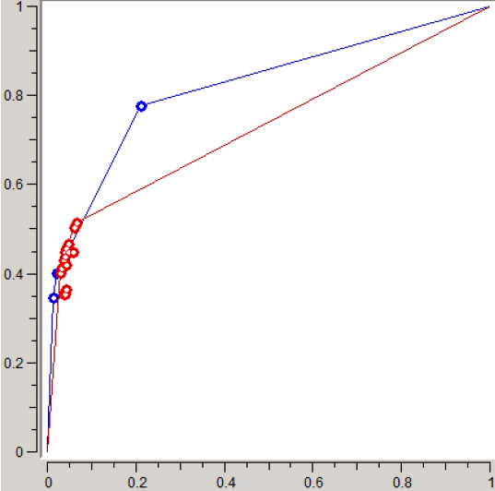
Visualisation of SD
ROC and Rule visualisation for KC2 (SD & CN2-SD)

Slide 19
Conclusions
Rules obtained using SD are intuitive but needed to be analysed by an expert.
The metrics used for classiﬁers cannot be directly applied in SD and need to be adapted.
Current and future work
  Further validation and application in other software engineering domains, e.g., project management.
  SD is a search problem!
    Development of new algorithms and metrics
      EDER-SD (Evolutionary Decision Rules SD) in Weka
      Unbalanced data (ROC, AUC metrics?), etc.
      Feature Selection (as a pre-processing step, part of the algorithm?, which metrics really influence defects)
      Discretisation
    Different search strategies and fitness functions (and multi-objective!)
      Use of global optimisation (set of metrics) vs. local metrics (individual metrics)

Slide 20
References
Kralj, P., Lavrac, N., Webb GI (2009) Supervised Descriptive Rule Discovery: A Unifying Survey of Constrast Set, Emerging Pateern and Subgroup Mining. Journal of Machine Learning Research 10: 377–403
Kloesgen, W. (1996), Explora: A Multipattern and Multistrategy Discovery Assistant. In: Advances in Knowledge Discovery and Data Mining, American Association for Artificial Intelligence, pp 249–271
Wrobel, S. (1997), An Algorithm for Multi-relational Discovery of Subgroups. Proceedings of the 1st European Symposium on Principles of Data Mining and Knowledge Discovery, Springer, LNAI, vol 1263, pp 78–87
Bay S., Pazzani, M. (2001) Detecting Group Differences: Mining Contrast Sets. Data Mining and Knowledge Discovery 5: 213–246
Dong, G., Li, J. (1999) Efficient Mining of Emerging Patterns: Discovering Trends and Differences. In: Proceedings of the 5th ACM SIGKDD International Conference on Knowledge Discovery and Data Mining, ACM Press, pp 43–52
Herrera, F., Carmona del Jesus, C.J., Gonzalez, P., and del Jesus, M.J., An overview on subgroup discovery: Foundations and applications, Knowledge and Information Systems, 2011 – In Press.
Gamberger, D., Lavrac, N.: Expert-guided subgroup discovery: methodology and application. Journal of Artificial Intelligence Research 17 (2002) 501–527
Lavrac, N., Kavsek, B., Flach, P., Todorovski, L.: Subgroup discovery with CN2-SD. The Journal of Machine Learning Research 5 (2004) 153–188
Clark, P., Niblett, T. (1989) , The CN2 induction algorithm, Machine Learning 3 261–283

